Slide 1

Attention & Executive Control
Chad Williams
University of Victoria

Slide 2
Lecture Outline
Attention
Endogenous & Exogenous
Visual Search
Attentional Components
Executive Functioning
Cognitive Effort
Cognitive Control

Slide 3
Lecture Outline
Attention
Endogenous & Exogenous
Visual Search
Attentional Components
Executive Functioning
Cognitive Effort
Cognitive Control

Slide 4
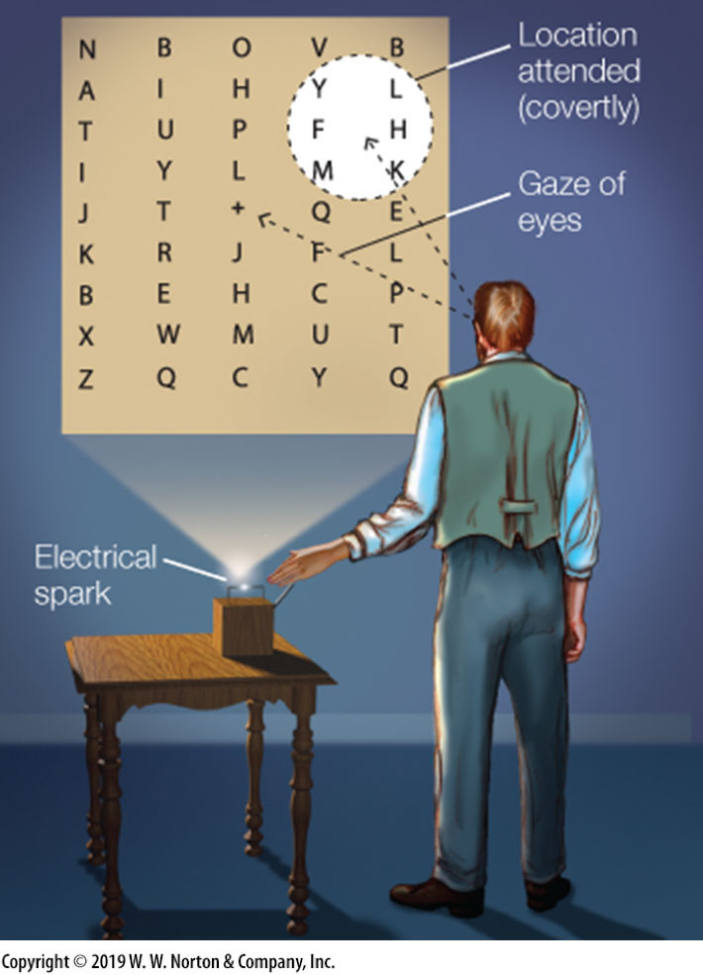
Attention
Attention: Process where we focus on one or more specific internal or external stimuli to enhance analysis
Overt Attention: Attention in focus of senses
Covert Attention: Attention not in focus of senses
Limits of Attention: Attention is limited in how many things it can focus on simultaneously
Difficult to focus on more than one thing
Attentional Spotlight: Metaphor for how we selectively focus our attention
Attend relevant stimuli
Ignore irrelevant stimuli

Slide 5

Attention
Attention
Endogenous Attention: Top-down, goal-driven process
Voluntary attention
Ability to intentionally attend to something
Exogenous Attention: Bottom-up, stimulus driven process
Involuntary attention
Pulling attention away from task

Slide 6
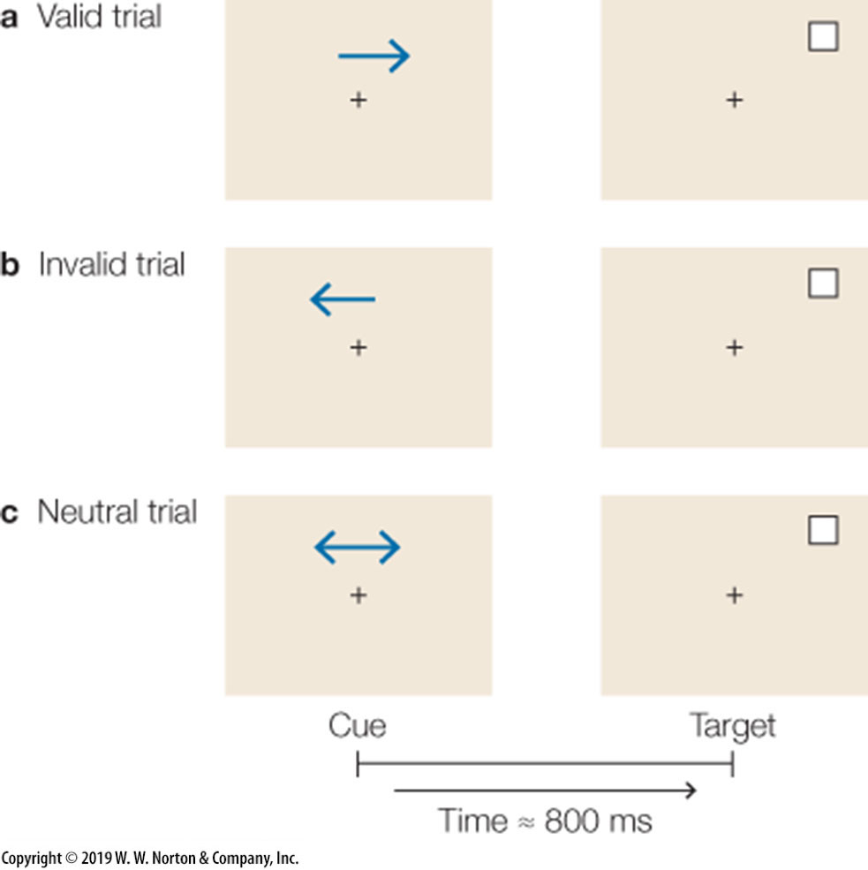
Attention
Endogenous Attention
Posner et al., 1980:
Research Question: Can we intentionally allocate our attention?
Task: Cued, left or right, with an arrow and then to respond to a target that is either on the left or right of the screen
IV: Whether the cue correctly identified the location of the target (valid) or not (invalid) or was noninformative (neutral)

Slide 7
+

Slide 11
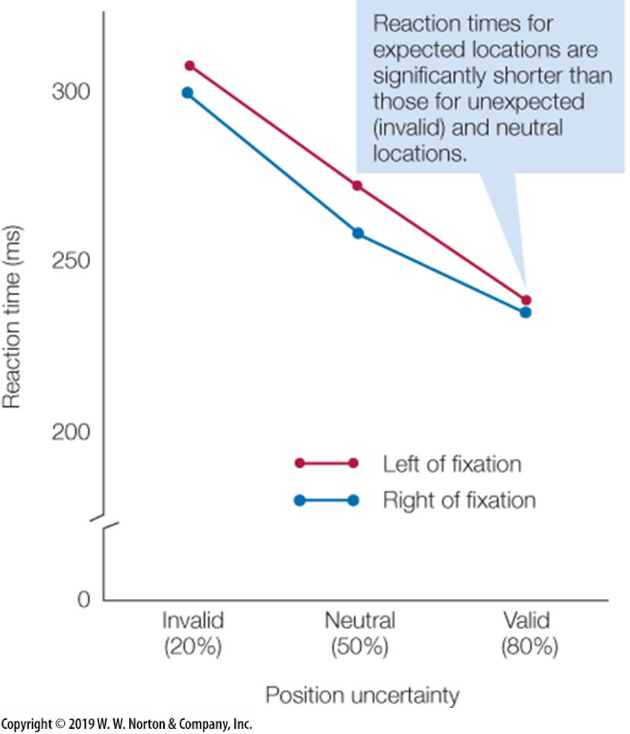
Attention
Endogenous Attention
Posner et al., 1980:
Results: Reaction time quickest with valid cue
Conclusion: Demonstrates the existence of endogenous, goal-driven, attention
Authors described this as an ‘attentional spotlight’

Slide 12
Attention
Exogenous Attention
Jonides, 1981
Research Question: Do we have an automatic attention capturing mechanism?
Task: Present a flash cue and then a target, participants are to respond to target
IV
Delay between cue and target varies from 50 – 300+ms
Whether the cue was valid or invalid with the target

Slide 13
Attention
Exogenous Attention
Jonides, 1981
Results
50-200ms: Faster responses for valid condition
300+ms: Reversed pattern
Conclusion
Evidence for an automatic attention mechanism
Evidence for inhibition of return
Inhibition of Return: Phenomenon where we are neglectful of a previously attended location of space

Slide 14
Lecture Outline
Attention
Endogenous & Exogenous
Visual Search
Attentional Components
Executive Functioning
Cognitive Effort
Cognitive Control

Slide 15
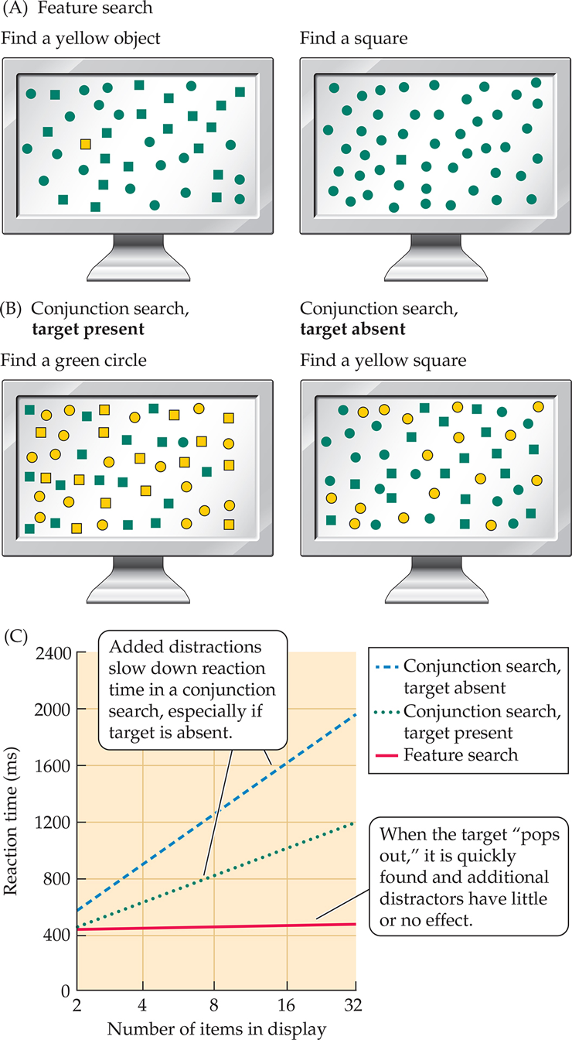
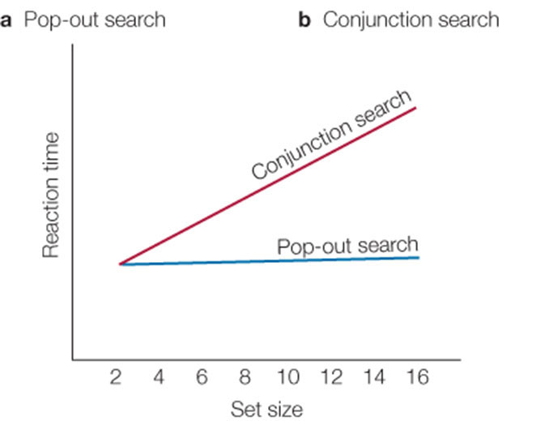
Attention
Visual Search: Process of identifying specific stimuli among distractor stimuli
Pop-Out Search: Easy to identify target if it is dissociable by a single feature
The feature is unique
Automatic, stimuli processed in parallel
Conjunction Search: Difficult to identify target if it shares multiple features with the distractors
No unique features, but unique conjunction of features
Effortful, stimuli processed serially
Feature Search: Attention towards different characteristics of the same stimuli

Slide 16
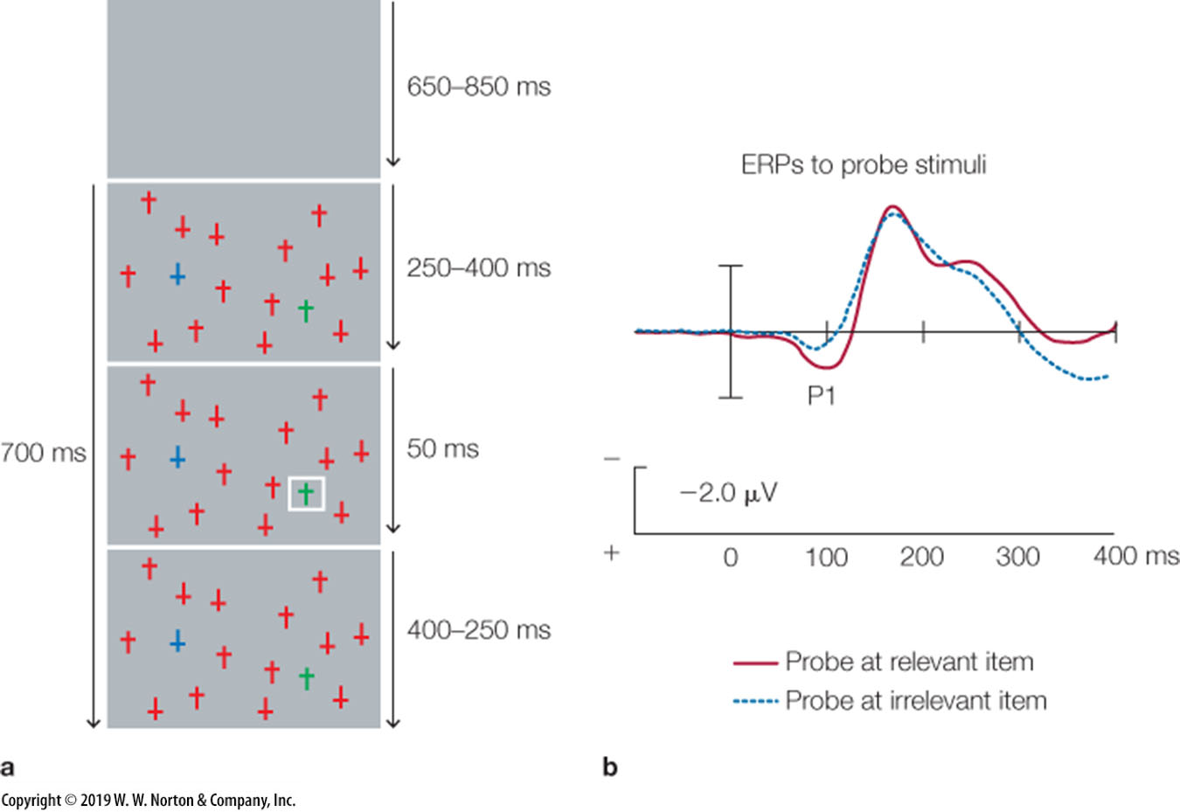
Attention
Visual Search
Luck et al., 1993
Research Question: Do we have an attentional spotlight that is sensitive to locations on the visual field?
Task
Complex stimuli with one pop-out distractor, and one pop-out target
A ‘spotlight’ then either flashed on the pop-out distractor or target
Respond by identifying whether stimuli is upright or upside down
IV: Whether the spotlight was on the target or distractor

Slide 17
Attention
Visual Search
Luck et al., 1993
Results: Increased P1for valid spotlight
P1: EEG neural signal, positive deflection at 100ms following stimulus
Conclusion: There exists spatial attention mechanisms in complex environments
P1 reflects a boosting of attention towards the target stimuli

Slide 18
Lecture Outline
Attention
Endogenous & Exogenous
Visual Search
Attentional Components
Executive Functioning
Cognitive Effort
Cognitive Control

Slide 19
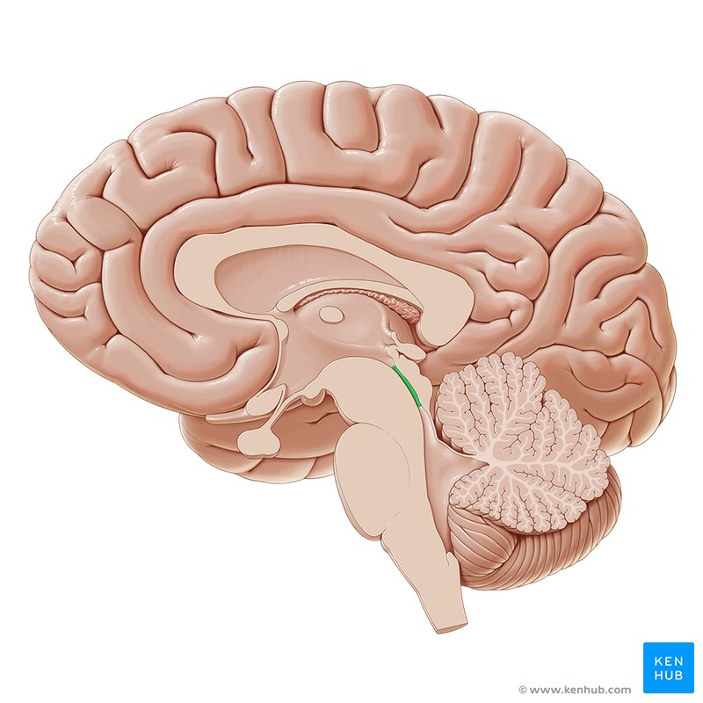
Attentional Components
Components of Attention
Alerting: Signal of preparatory attentional need
A ‘when’ signal to switch out of a resting state towards a preparatory state
Only exists with endogenous control
Orienting: Control of attention towards location or modality
A ‘where’ signal used to prioritize target information and disengage from other information
Executive: Top-down influence to maintain important information
Determining how mental resources will be used (e.g., cognitive control)

Slide 21
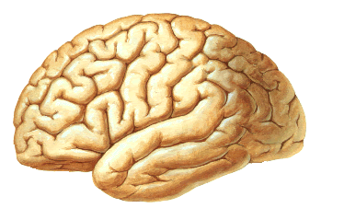
Attentional Components
Parietal Cortex
Alerting
Frontal Cortex
Sustains alert state
Top-down readiness to respond
Parietal Areas
Maintains vigilance
Detects stimulus onset for orienting
Frontal Cortex

Slide 22
Attentional Components
Ventral Frontal Cortex
Intraparietal Sulcus
Orienting
Ventral Frontal Cortex: Disengages attention from the current focus
Temporoparietal Junction: Reorientation of attention
Exogenous: bottom-up, reflexive orienting
Intraparietal Sulcus: Directs and maintains attentional spotlight toward relevant locations, features, and objects
Endogenous: top-down voluntary orienting
Temporoparietal junction

Slide 23
Attentional Components
Supplementary
Motor Area
Executive
Pre-Supplementary Motor Area
Target detection and awareness
Sustained maintenance of attention
Response preparation
ACC
Conflict detection
Sustained attentional effort
Dorsolateral PFC
Maintains goal-relevant information
Resolves conflict
ACC
Dorsolateral
PFC

Slide 24
Lecture Outline
Attention
Endogenous & Exogenous
Visual Search
Attentional Components
Executive Functioning
Cognitive Effort
Cognitive Control

Slide 25
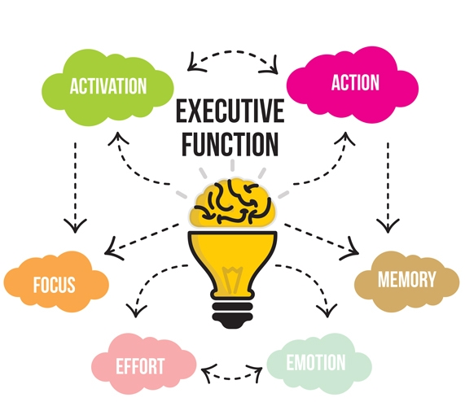
Executive Functioning
Executive Functioning: Suite of high-level cognitive processes that require mental effort to plan, regulate, and direct behaviour toward goals
Recruited when there is a need for effort

Slide 26


Slide 32
Executive Functioning
Executive Functioning: Suite of high-level cognitive processes that require mental effort to plan, regulate, and direct behaviour toward goals
Recruited when there is a need for effort
Cognitive control determines whether we must exert effort by recruiting these high-level processes
Cognitive Control: A signal to indicate whether there is a need for effort
Mechanism that regulates and coordinates high-level processes
Cognitive Effort: Engaging with an effortful task by recruiting high-level processes
Processes include attention, working memory, inhibition, cognitive flexibility, planning, and decision-making

Slide 33
Executive Functioning
In a lake, there is a patch of lily pads. Every day, the patch doubles in size. If it takes 48 days for the patch to cover the entire lake, how long would it take for the patch to cover half of the lake?
47 days

Slide 34
Executive Functioning
COGNITIVE CONTROL:
Should I exert effort?
No
Yes
Rely on associative/habitual responses
Recruit executive functioning

Slide 35

Executive Functioning
Types of Processing
System 1: Fast, automatic, effortless
Take $100 or enter a draw for a 10% chance of $200?
Recruits automatic processes
E.g., associative thinking, habitual responses
System 2: Slow, contemplative, effortful
Take $100 or enter a draw for a 10% chance of $1200?
Recruits executive functioning processes
E.g., reasoning, working memory

Slide 36

Two Modes of Thinking
System 1
Automatic, quick, effortless
Innate, animalistic
Associative, efficient
No voluntary control
System 2
Deliberate, slow, effortful
Learned, civilized
Analytical, laborious
Sense of agency, choice

Slide 37
Executive Functioning
COGNITIVE CONTROL:
Should I exert effort?
No
Yes
System 1
System 2

Slide 38
Lecture Outline
Attention
Endogenous & Exogenous
Visual Search
Attentional Components
Executive Functioning
Cognitive Effort
Cognitive Control

Slide 39
Executive Functioning
COGNITIVE CONTROL:
Should I exert effort?
No
Yes
System 1
System 2

Slide 40
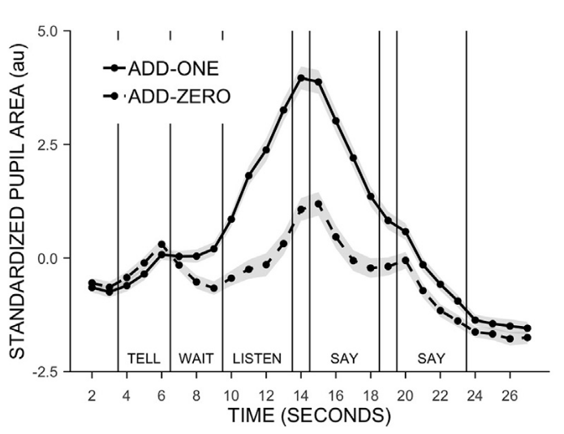
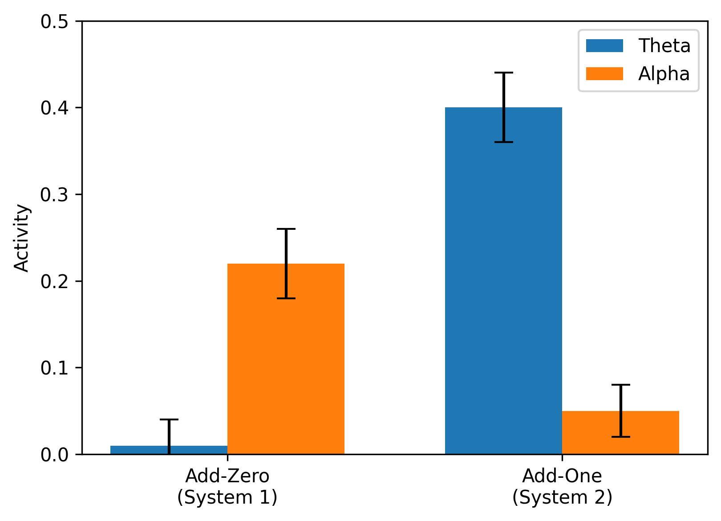
Executive Functioning
Williams et al., 2019
Research Question: Are there differing neural systems of effortless (System 1) and effortful (System 2) processing?
Methods: Participants completed the add-one task, where they heard four numbers and were either to repeat those numbers or add one to each of them
Pupil size and EEG data were recorded

Slide 41


Slide 42
Executive Functioning
Williams et al., 2019
IV
Add-Zero: Repeat the numbers as heard
Add-One: Add one to each number
DV:
Pupil size
EEG activity looking at theta and alpha
Theta is within the prefrontal cortex
Known to correlate with an engaged state
Alpha is within the parietal cortex
Known to correlate with a calm state

Slide 43
Executive Functioning
Williams et al., 2019
Results
Pupil size was larger for the add-one condition
Alpha activity engaged in add-zero (system 1)
Not engaged in the add-one (system 2) condition
Theta activity engaged in add-one (system 2)
Not engaged in the add-zero (system 1) condition
Conclusion: Dissociated neural systems for system 1 and system 2 processing
System 1 recruits low-level parietal regions
System 2 recruits high-level frontal regions

Slide 44
Lecture Outline
Attention
Endogenous & Exogenous
Visual Search
Attentional Components
Executive Functioning
Cognitive Effort
Cognitive Control

Slide 45
Executive Functioning
COGNITIVE CONTROL:
Should I exert effort?
No
Yes
System 1
System 2

Slide 46

Executive Functioning
Effort (System 2) pulls from a limited resource
Law of least effort
We cherish this resource, so we avoid effort
We conserve energy for things we are motivated to do
System 1 will handle most
System 2 intervenes only when it has to

Slide 47
Executive Functioning
Expected Value of Control Theory
We conduct a cost-benefit computation to determine whether we should exert effort
What constitutes a cost and a benefit is under investigation, but mostly unknown
May be too diverse and context-specific to fully describe in a list
Costs: Diverse such as monetary costs, time costs, energy we have in a day
Benefits: Diverse such as a paycheque, a good grade, social praise, intrinsic pride

Slide 48
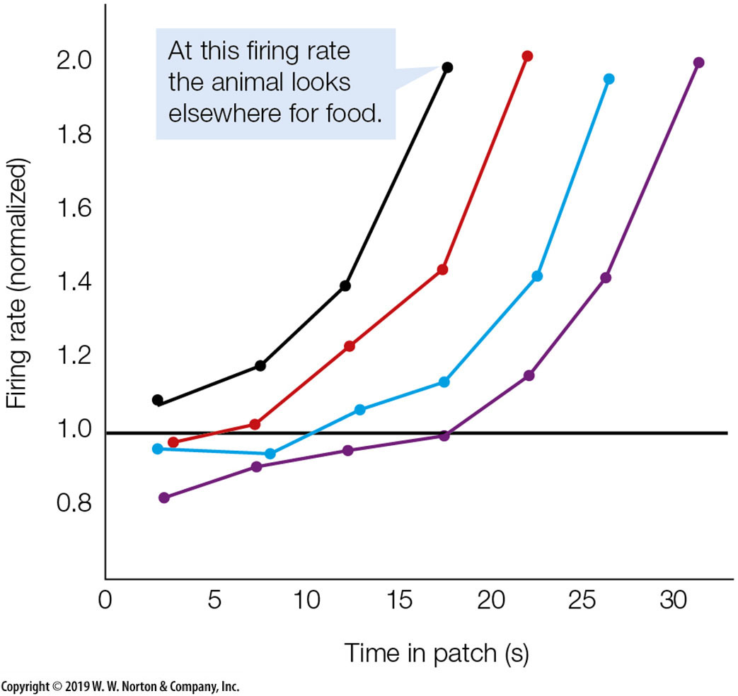
Executive Functioning
Hayden, 2011
Research Question: What does the ACC code for during decision making?
Task
Monkey may remain at current stimulus each trial and receive depreciating reward
or choose to forgo reward for a certain time to reach a different stimulus with unknown reward
IV: Monkeys decision to explore or exploit
DV: Neural activity in the ACC
Used extracellular recordings

Slide 49



Executive Functioning
Sour
Berry
Sour
Berry
Sour
Berry
Tasty
Berry
Tasty
Berry
Sour
Berry
Sour
Berry
Tasty
Berry
Sour
Berry
Tasty
Berry
Tasty
Berry
Tasty
Berry
Sour
Berry
Sour
Berry
Sour
Berry
Tasty
Berry
Tasty
Berry
Sour
Berry
Sour
Berry
Tasty
Berry
Sour
Berry
Tasty
Berry
Tasty
Berry
Tasty
Berry
?

Slide 50
Executive Functioning
Hayden, 2011
Results: ACC activity was proportional to the likelihood the monkey will undergo effort to get new patch
Conclusion: ACC codes the engagement of control to adapt behaviour
Codes the expected payoff of engaging cognitive control (and exploring)
BOLD signals in ACC show similar pattern where it correlates with explore likelihood, regardless of participant choice

Slide 51
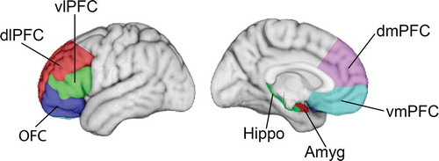
Executive Functioning
Prefrontal Cortex (PFC) in general
Goal setting and planning
Sustained and selective allocation of attention
Anterior Cingulate Cortex (ACC)
Monitoring for conflict and errors
Signaling for the need of increased control
Dorsolateral PFC (dlPFC)
Maintenance and manipulation in working memory
Conflict resolution
ACC

Slide 52
Executive Functioning
Ventrolateral PFC (vlPFC)
Inhibiting a dominant but incorrect response
Ventromedial PFC (vmPFC)
Representing subjective value to guide choices
Integrating emotions in decision making
Orbitofrontal Cortex (OFC)
Evaluating reward value of possible actions
Updating expectations based on outcome
ACC

Slide 53

Testable Figures
Slide 15
Slides 21-23
Slide 51
All figures corresponding to the results of a study are testable material.

